Slide 1
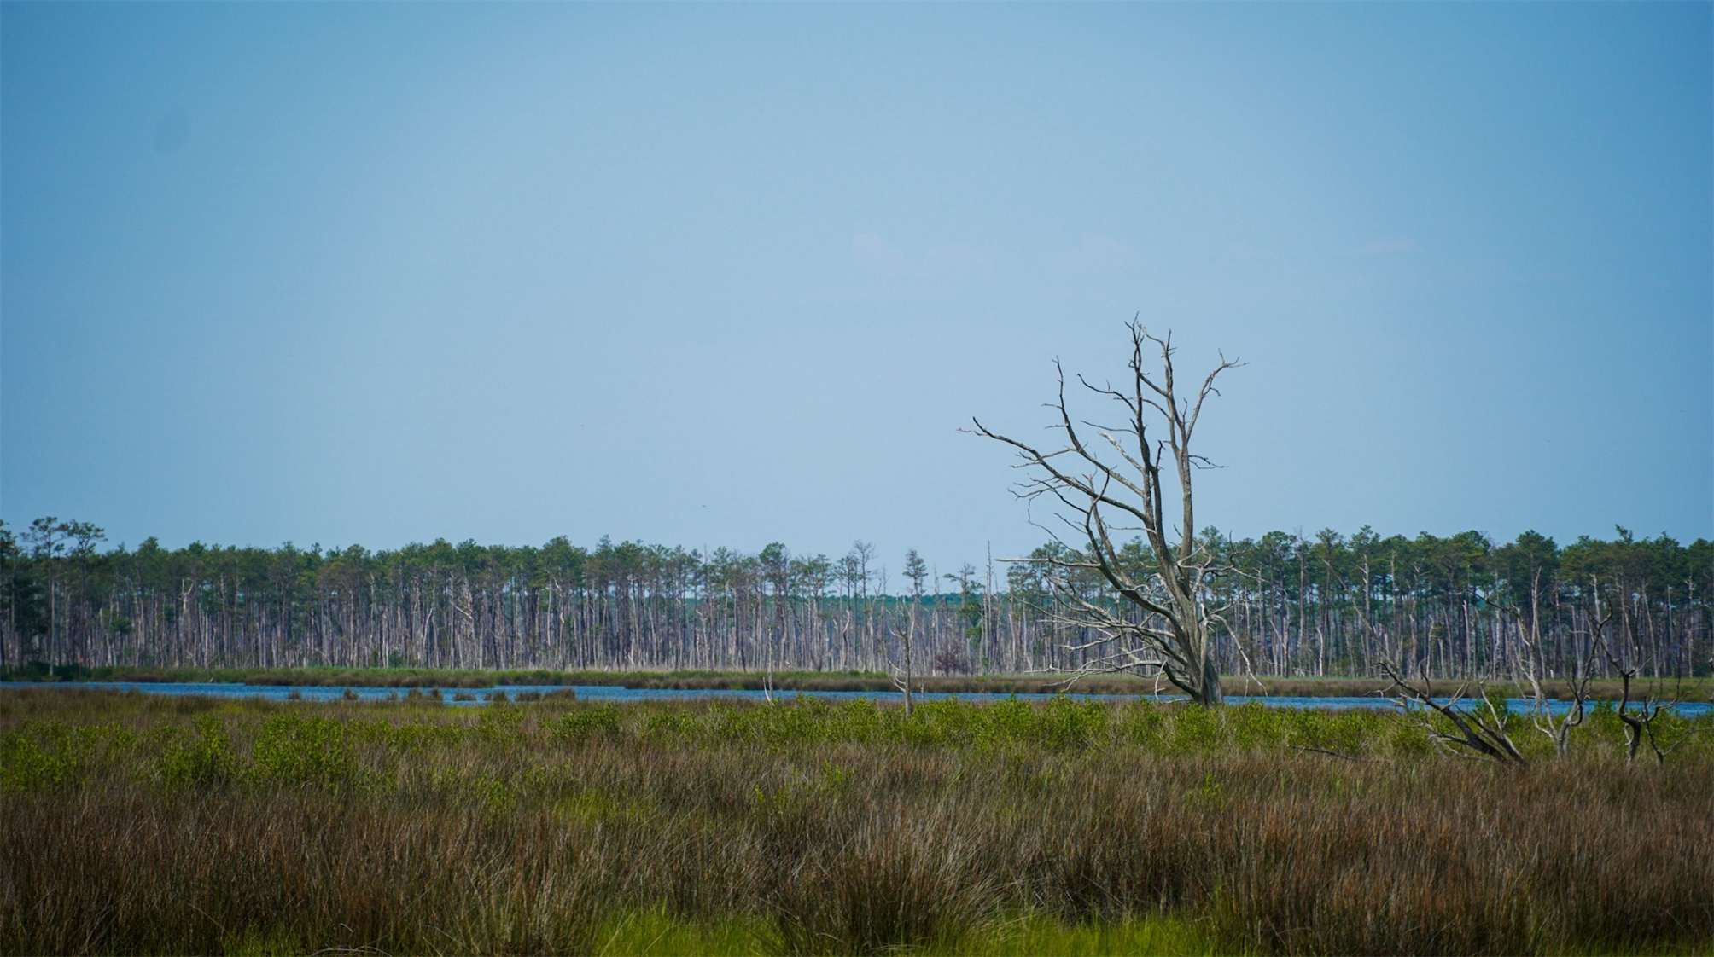
Ghost Forest Detection along Coastal Areas of the United States East Coast Using Satellite Imagery
Mahin Ganesan, Tom Lever, Brendan Jalali, Nicholas Miller
05/01/2025
Notes:
Brendan

Slide 2
Table of Contents
Background
Data Overview
Methodology
Results
Notes:
Brendan

Slide 3

Background
Notes:
Brendan

Slide 4

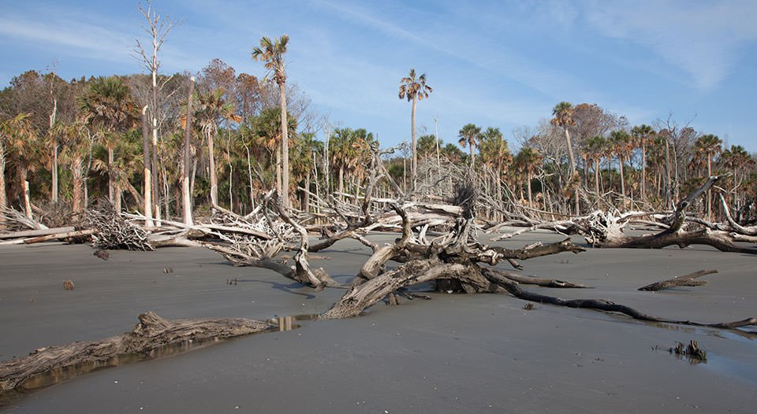
Background
What is a ghost forest?
Coastal ecosystem impacted by saltwater intrusion
Indicates environmental collapse and carbon release
Notes:
Brendan
Ghost Forests - Groups of dead trees along a coastline
These forests store a disproportionally large amount of carbon from the environment

Slide 5
Purpose
Identify ghost forests across the US
Support our sponsors at the Environmental Science Department at UVA
Notes:
Brendan – forests look messy, cannot detect with just satellite, so focusing on a by tree basis

Slide 6
Data Overview
Notes:
Tom

Slide 7
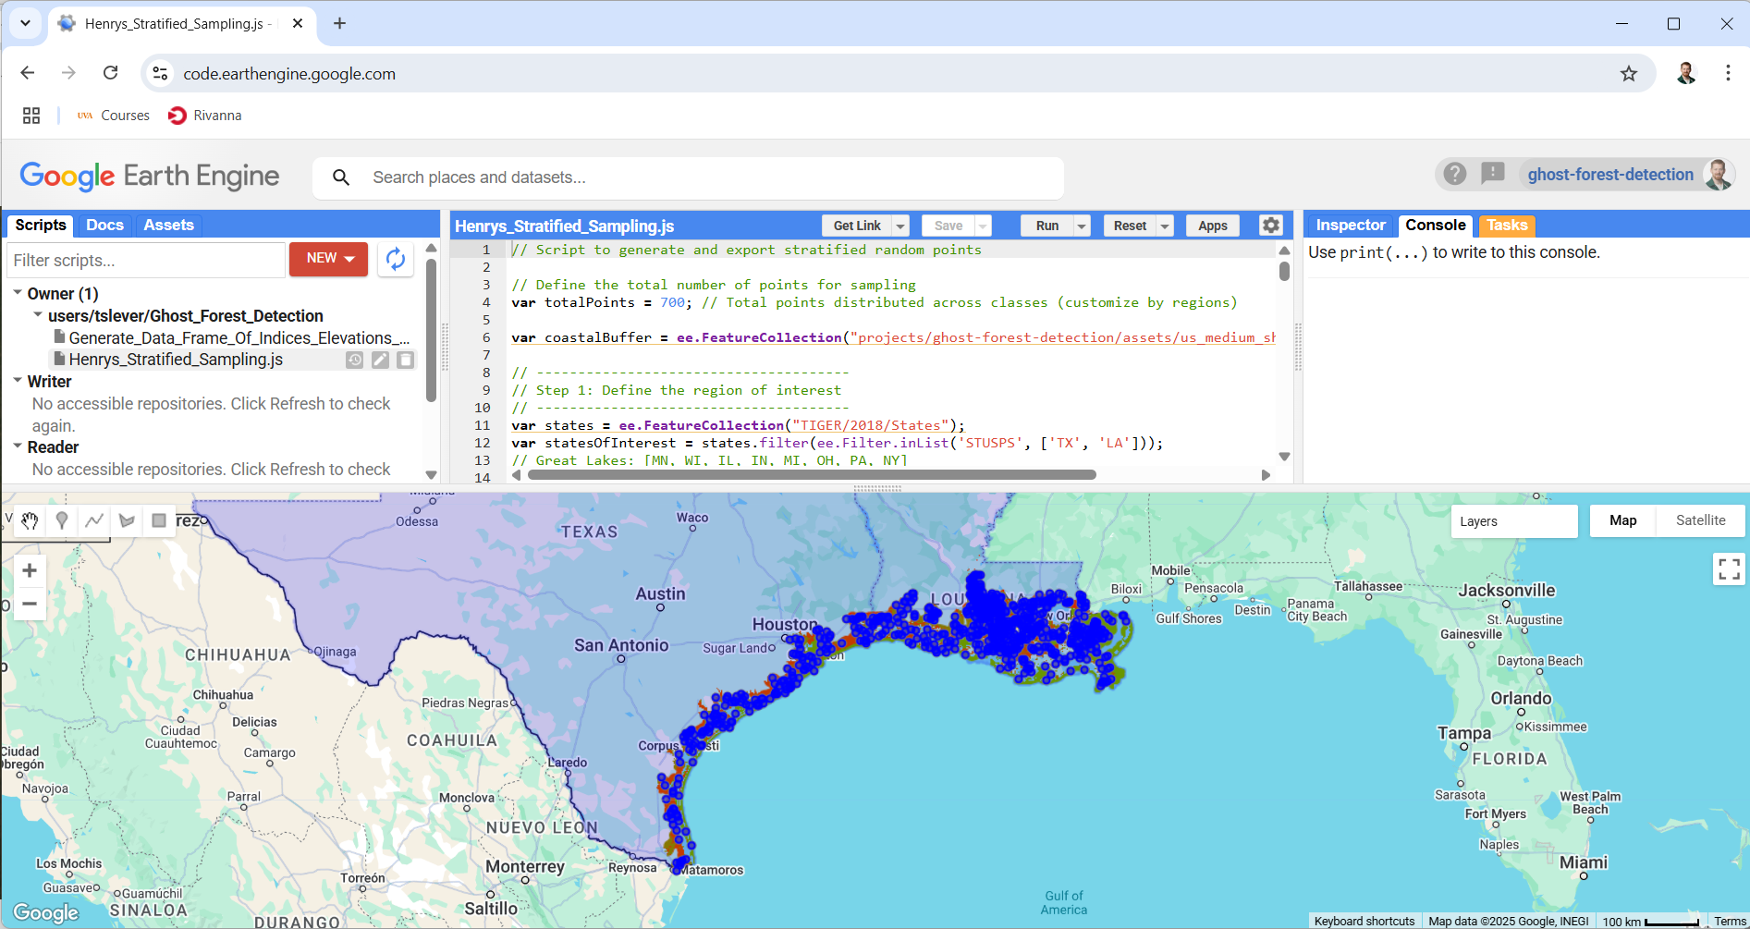
Initial Data Collection
Notes:
We used Google Earth Engine to create a table of 1000s of locations with latitudes, longitudes, and indicators of whether dead trees were present.
Each location is in the coastal United States and has an elevation between 0 and 10 meters.
Satellite images were of forests, wetlands, and human development.
A data annotation company will provide annotation images with polygons around dead trees.

Slide 8
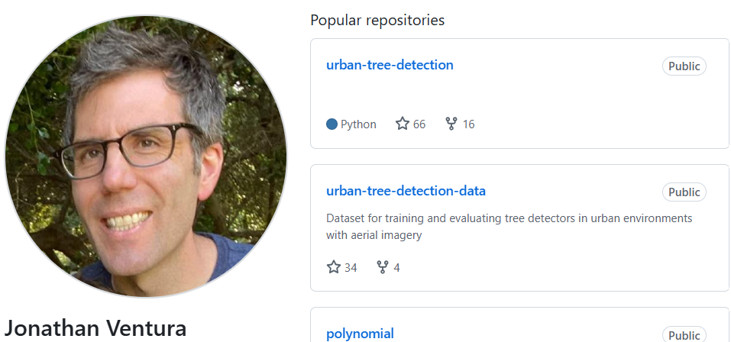
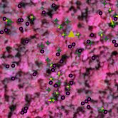
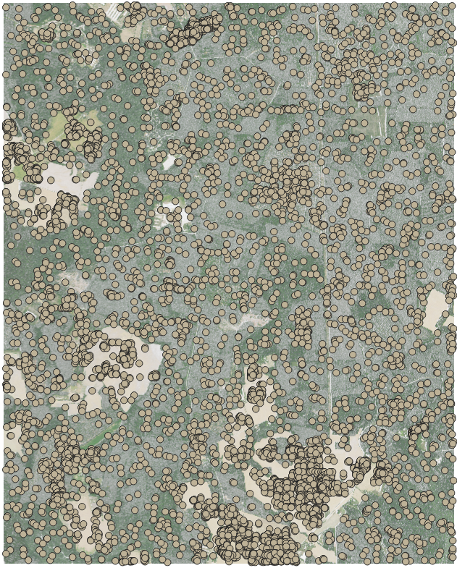
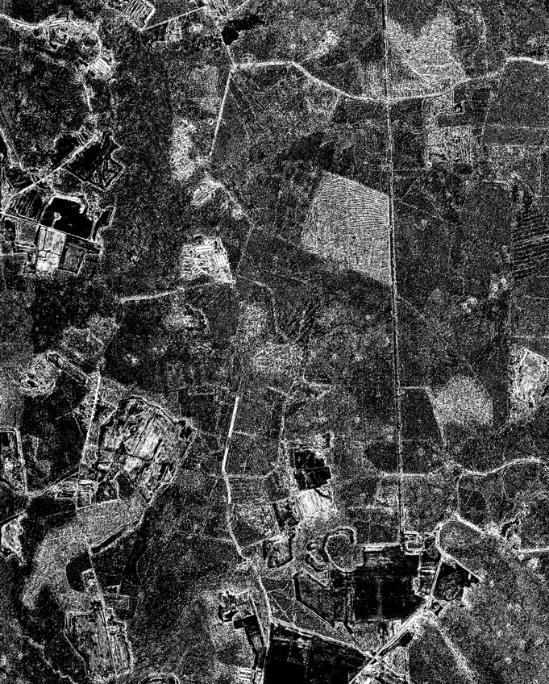
Deliverables
Notes:
We adapted Jon Ventura's CNN urban-tree-detection to create labeled testing images.
We also produced geospatial layers of locations, and maps of probabilities that pixels represented dead trees.

Slide 9
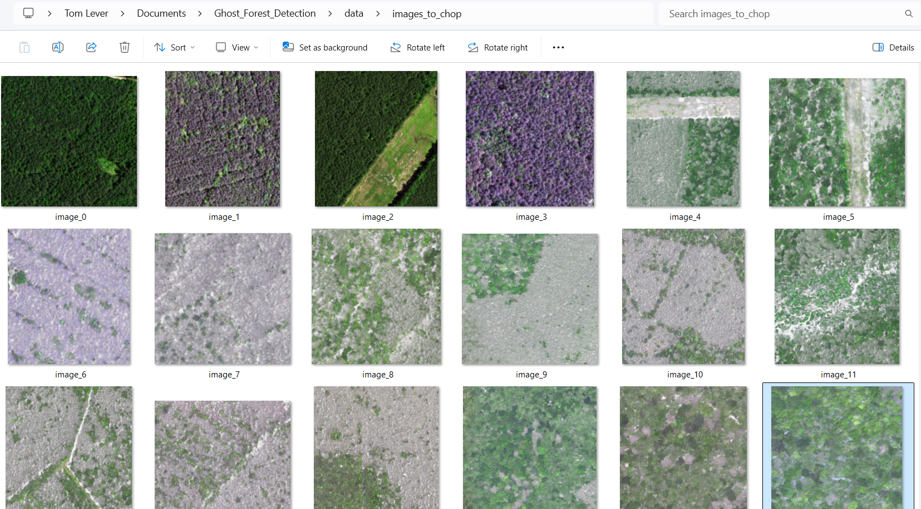

Data Pipeline
Notes:
We developed a full data pipeline to the outputs you saw.
We were given channels of satellite images of the East Coast and annotation images with vertices of polygons.
We processed bands into small color images and created tables of coordinates of centroids of dead trees.
We prepared small, full, and augmented data archives for training, validation, and testing.
We corrected, rewrote, upgraded, enhanced, and documented Jon Ventura's CNN.
We developed training resuming, early stopping, new training and testing outputs, and cousin models.
We trained, validated, tested, and performed inference with all of our configurations.

Slide 10
Assumptions & Limitations
Dead Trees are Detectable Objects
Annotated Data is Accurate and Representative
Model Generalizability
Seasonal and Lighting Variability
Notes:
Nick

Slide 11
Methodology
Notes:
Split

Slide 12
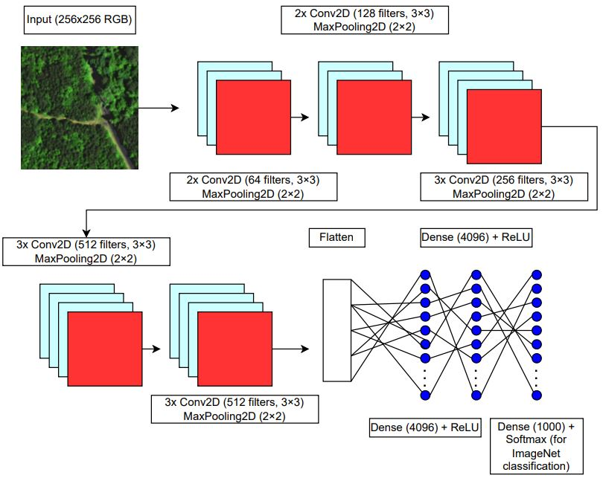
Modeling
VGG16 architecture
Adapts from current research paper (Ventura et al.)
Outputs attention & confidence maps
Combines MSE & BCE loss
Notes:
Mahin

Slide 13
Alternative Architectures
ResNet
Adds skip connections to allow for deeper networks by mitigating vanishing gradients
EfficientNet
Optimizes accuracy and efficiency by scaling network dimensions like depth, width, and resolution
Notes:
Mahin

Slide 14
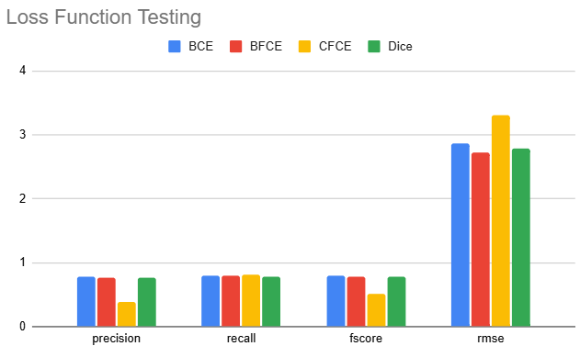
Loss Functions
Binary Focal Cross Entropy
Categorical Focal Cross Entropy
Dice Loss
Binary Cross Entropy
Notes:
Nick

Slide 15
Data Augmentation
Transformation Types
90-degree rotations
Vertical flips
Brightness and contrast changes
Cropping
Notes:
Brendan
Scale factor 4
Increased robustness

Slide 16
Results
Notes:
Mahin

Slide 17
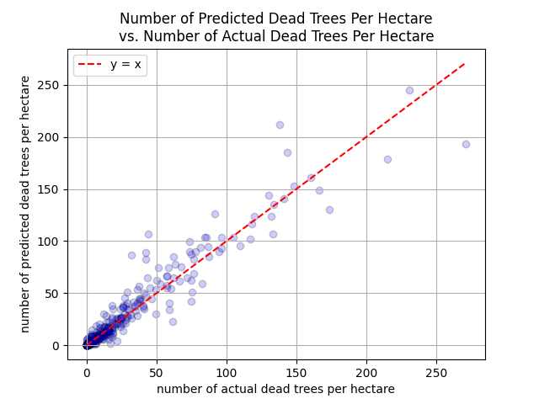
Performance Metrics
Metric | Testing
Precision | 77.5%
Recall | 81.6%
F1 Score | 79.5%
RMSE | 2.82
Notes:
Mahin

Slide 18
Conclusion
Final model can serve as a valuable resource for future environmental monitoring efforts
Scale our detection pipeline to new locations beyond the East Coast
Help build out a foundation for conservation policy and support coastal ecosystems and communities
Notes:
Mahin

Slide 19



Acknowledgements
Herman Shakeri
Xi Yang
Henry Yeung
Notes:
Mahin

Slide 20




The Ghost 'Forest' Busters
Mahin Ganesan
Brendan Jalali
Thomas Lever
Nicholas Miller
Notes:
Mahin

Slide 21
Questions?
Notes:
Mahin

